Slide 1
Multiple Organ Dysfunction Syndrome (MODS)
Student’s Name
Institutional Affiliation
Date

Slide 2
Definition and Introduction
MODS is a disease which develops from reversible physiological disorder which involves different organ systems that results in admission of patient to ICU or leading to life threatening health status.
The condition results to from disruption of homeostasis between two or more organs which requires a medical intervention to ensure physiological functioning (Hazeldine et al., 2017).
MODS is influenced by the present of infection, injury or illness which leads to hypometabolism and immunodepression.
The disease commonly affects the kidneys, liver, lungs and the heart.
Notes:
MODS is a condition which develops from reversible physiological disorder which involves various organ systems leading to admission of patients in ICU. The condition results to from disruption of homeostasis between two or more organs which requires a medical intervention to ensure physiological functioning.
MODS is influenced by the present of infection, injury or illness which leads to hypometabolism and immunodepression.The disease commonly affects the kidneys, liver, lungs and the heart

Slide 3
Risk Factors
Genetic predisposition- an individual who family members are affected with the disease may be predispose to the development of the condition. More so the severity of the disease is triggered by genetics and familial exposure.
Premorbid organ dysfunction- organ dysfunction that is caused by the presence of a previous disease may lead to the development of MODs. Kidney and liver dysfunction may predispose a patient to the development the failures of the organs leading to multiple dysfunctions (Hazeldine et al., 2017).
ICU support, medications and therapies may influence organ trauma which may lead to multiple organ dysfunction
Notes:
Genetic predisposition of individual whose family members are affected with the disease may be predispose to the development of the condition. More so the severity of the disease is triggered by genetics and familial exposure. Premorbid organ dysfunctions caused by the presence of a previous disease may lead to the development of MODs. Kidney and liver dysfunction may predispose a patient to the development the failures of the organs leading to multiple dysfunctions.
ICU support, medications and therapies may influence organ trauma which may lead to multiple organ dysfunction.

Slide 4
Infections also predispose people to MODS. When infections occurs to different organs leading to damages, MODS occurs. Infections such as peritonitis, paracolic abscesses and amoebic colitis have been linked to the development of MODS (Hazeldine et al., 2017).
Other risk factors includes:
Injuries
Surgery
Shock
Blood transfusions
Notes:
Infections also predispose people to MODS. When infections occurs to different organs leading to damages, MODS occurs. Infections such as peritonitis, paracolic abscesses and amoebic colitis have been linked to the development of MODS
Other risk factors include Injuries, Surgery, Shock and Blood transfusions.

Slide 5
Pathogenesis
MODS is influenced by the presence of uncontrolled, overwhelming inflammatory response which is activated by external stimuli such as severe trauma, hypovolemic shock and sepsis leading to extensive injuries to tissues.
The inflammatory response activation results to loss of the ability of the host to localize the inflammation which leads to systemic inflammation and tissue damage which results to MODS (Hazeldine et al., 2017).
The major player of the development of the disease includes the oxidants, cytokines, endotoxin, macrophages, and neutrophils.
The presence of tissue toxicity, impaired tissue perfusion, systemic hypotension and sepsis enhances the development of multiple organ dysfunction.
Notes:
MODS is influenced by the presence of uncontrolled, overwhelming inflammatory response which is activated by external stimuli such as severe trauma, hypovolemic shock and sepsis leading to extensive injuries to tissues. The inflammatory response activation results to loss of the ability of the host to localize the inflammation which leads to systemic inflammation and tissue damage which results to MODS. The major player of the development of the disease includes the oxidants, cytokines, endotoxin, macrophages, and neutrophils. The presence of tissue toxicity, impaired tissue perfusion, systemic hypotension and sepsis enhances the development of multiple organ dysfunction.

Slide 6
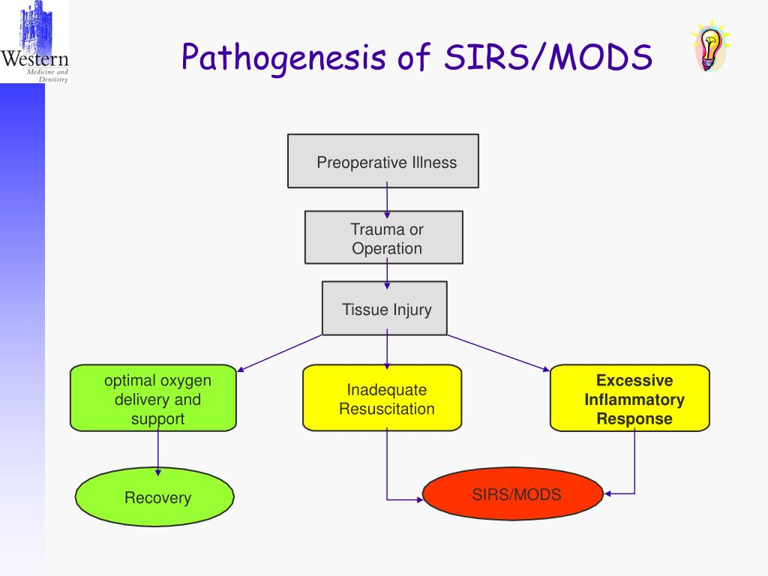
Retrieved from: https://www.google.com/url?sa=i&url=https%3A%2F%2Fwww.slideserve.com%2Fxarles%2Fsirs-sepsis-and-mods&psig=AOvVaw2ZYxG9tz9Z-89_GKP8fucQ&ust=1614340593677000&source=images&cd=vfe&ved=0CAIQjRxqFwoTCODE1dX9hO8CFQAAAAAdAAAAABAD

Slide 7
Primary and Secondary MODS
Primary MODS occurs through direct hypoxemia, hemorrhage or injury.
Secondary MODS occurs in the process of acute disease and results from a second event which activates SIRS (systemic inflammatory syndrome) (Hazeldine et al., 2017).
The direct damage to the organs is caused by the inflammation which may no proceed to SIRS such as pulmonary injury and aspiration.
Secondary MODS is as a result of widespread infection to the systems which is followed by hypermetabolic condition which lasts for 21 days.
Unless the patient is treated, the condition can lead to septic shock leading to mortality.
Notes:
Primary MODS occurs through direct hypoxemia, hemorrhage or injury. On the other hand, secondary MODS occurs in the process of acute disease and results from a second event which activates SIRS (systemic inflammatory syndrome).
The direct damage to the organs is caused by the inflammation which may no proceed to SIRS such as pulmonary injury and aspiration. Secondary MODS is as a result of widespread infection to the systems which is followed by hypermetabolic condition which lasts for 21 days. Unless the patient is treated, the condition can lead to septic shock leading to mortality.

Slide 8
Reference
Hazeldine, J., Naumann, D. N., Toman, E., Davies, D., Bishop, J. R., Su, Z., ... & Lord, J. M. (2017). Prehospital immune responses and development of multiple organ dysfunction syndrome following traumatic injury: A prospective cohort study. PLoS medicine, 14(7), e1002338.

